Slide 1
“Credit Card Project” Report
By: Ghadeer Kurdi, and Ghadah Fadalah

Slide 2
Dataset Description
* CUSTID : Identification of Credit Card holder (Categorical)
* BALANCE : Balance amount left in their account to make purchases (
* BALANCEFREQUENCY : How frequently the Balance is updated, score between 0 and 1 (1 = frequently updated, 0 = not frequently updated)
* PURCHASES : Amount of purchases made from account
* ONEOFFPURCHASES : Maximum purchase amount done in one-go
* INSTALLMENTSPURCHASES : Amount of purchase done in installment
* CASHADVANCE : Cash in advance given by the user
* PURCHASESFREQUENCY : How frequently the Purchases are being made, score between 0 and 1 (1 = frequently purchased, 0 = not frequently purchased)
* ONEOFFPURCHASESFREQUENCY : How frequently Purchases are happening in one-go (1 = frequently purchased, 0 = not frequently purchased)
* PURCHASESINSTALLMENTSFREQUENCY : How frequently purchases in installments are being done (1 = frequently done, 0 = not frequently done)
* CASHADVANCEFREQUENCY : How frequently the cash in advance being paid
* CASHADVANCETRX : Number of Transactions made with "Cash in Advanced"
* PURCHASESTRX : Numbe of purchase transactions made
* CREDITLIMIT : Limit of Credit Card for user
* PAYMENTS : Amount of Payment done by user
* MINIMUM_PAYMENTS : Minimum amount of payments made by user
* PRCFULLPAYMENT : Percent of full payment paid by user
* TENURE : Tenure of credit card service for user

Slide 3
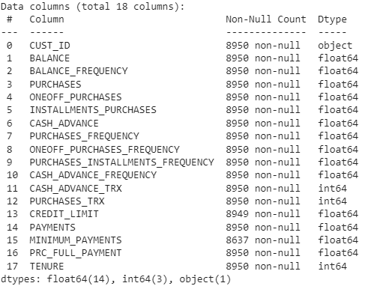
Data Info
After importing needed libraries and reading the dataset csv file “downloaded from kaggle” , we found that it contains:
18 columns with 17 features in addition to “CUST_ID” column
14 columns are numerical floats with 3 numerical integer columns in addition 1 object column with is “CUST_ID”
8950 customer (instance)
Some missing values in 2 columns

Slide 4
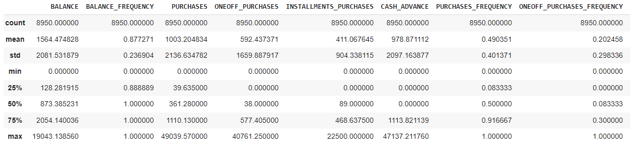
Descriptive statistics
At the first glance, we expect having skewed distributions dominating on all features here, especially when comparing each feature Mean and Median, besides having extreme values.

Slide 5
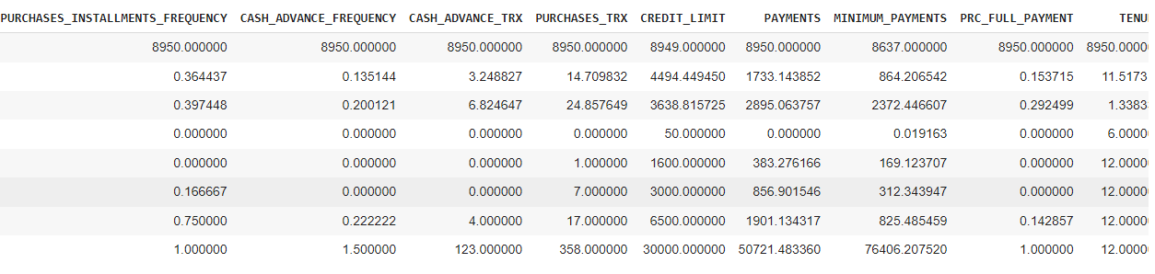
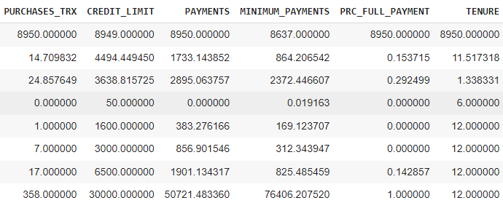

Slide 6
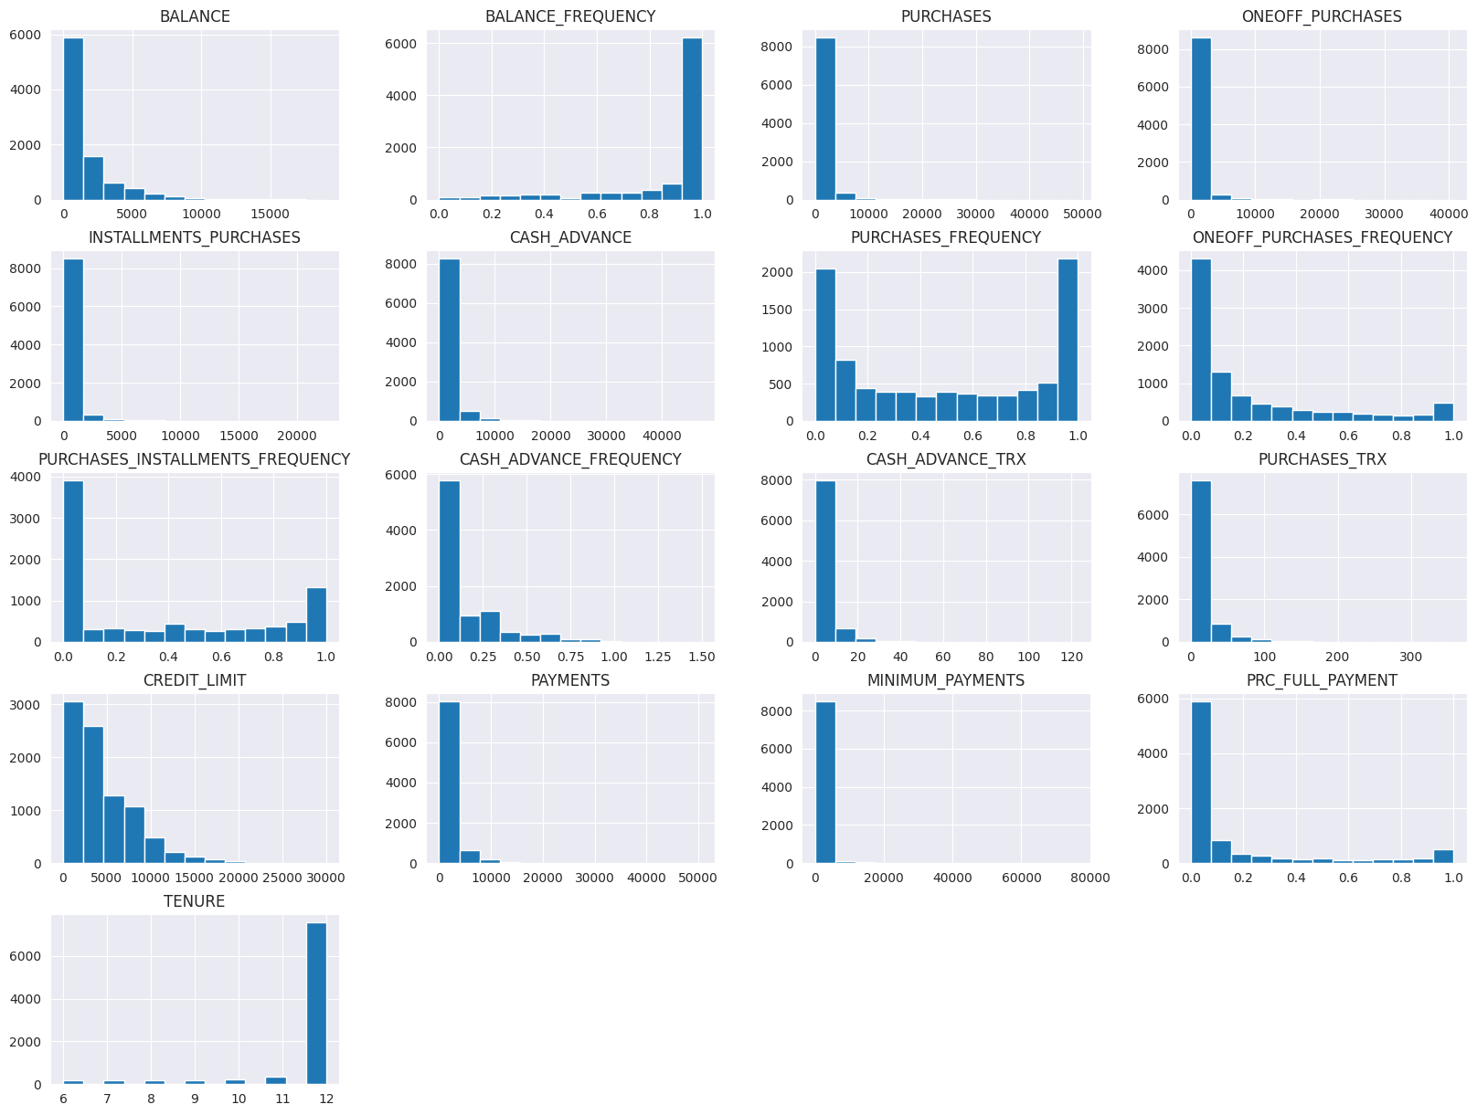
Univariate analysis
Analysis numerical features using histogram, gave us an idea
on how data is distributed in each feature, and the benefit of knowing that Most of the features are skewed:
To the right:
BALANCE_FREQUENCY
TENURE
To the left: ALL Other features except :
PURCHASES_FREQUENCY

Slide 7
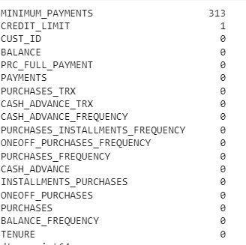

Checking for Missing values (NaN)

Slide 8

Checking for Duplicates
No duplicates was found either with or without CUST_ID column.

Slide 9
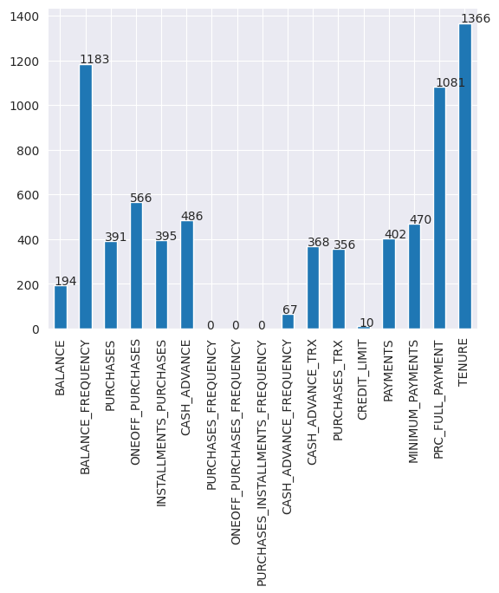
Checking for Outliers
Since our data has Skewed distribution, we used Q1 - 3 IQR and Q₃ + 3 IQR as to set boundaries to check the outliers & this reveals that:
There are 14 columns that has outliers according to the equation.

Slide 10
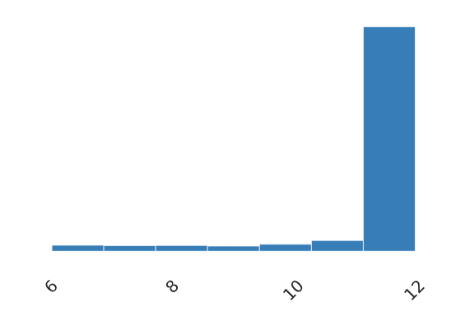
Looks like most of our instances belong to tenure 12 and this explains its skewness
TENURE

Slide 11
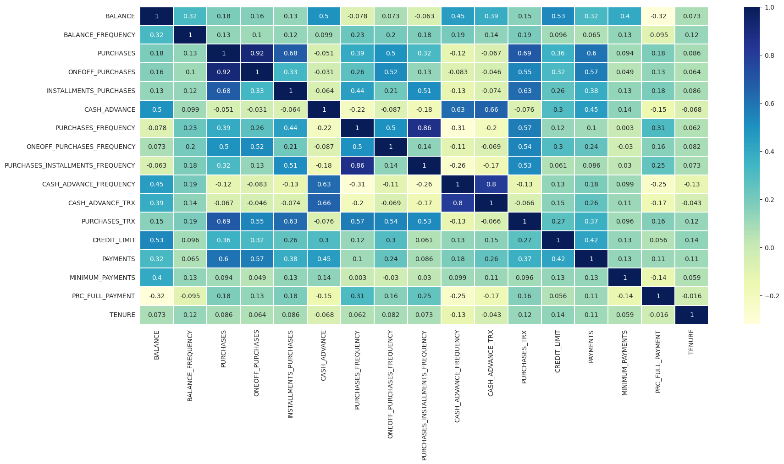
Some variables have moderate to high correlation values to other variables (>0.5 to 1)
PURCHASES and ONEOFF_PURCHASES (0.92 )
CASH_ADVANCE_TRX with CASH_ADVANCE_FREQUENCY (0.8 ).
Correlational multivariate analysis

Slide 12
Outliers
Preprocessing
Missing values
Standardization /Normalization

Slide 13
Handling Missing values
Using Knn function, we substituted NaN with nearst value since our data have outliers

Slide 14
Normalization
Using Log transformation function, we transformed numerical data since our data have outliers

Slide 15
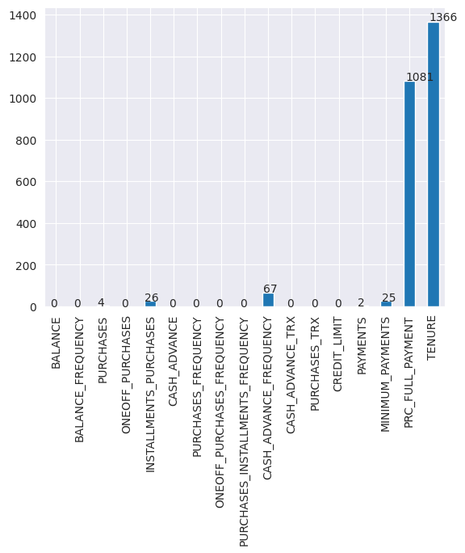
Outliers Imputaion with Knn

Slide 16
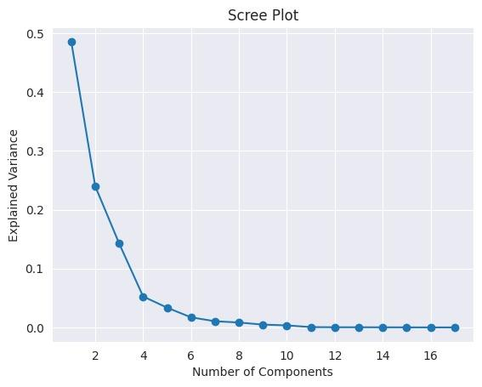
PCA and dimensionality reduction
We usually use PCA to reduce the number of features while saving as much information as possible, here we use it to reduce the number of features from 17 to 4 components using the elbow method to get the best number of components to choose.

Slide 17
Models
K-means
MiniBatch K-means
DBSCAN

Slide 18
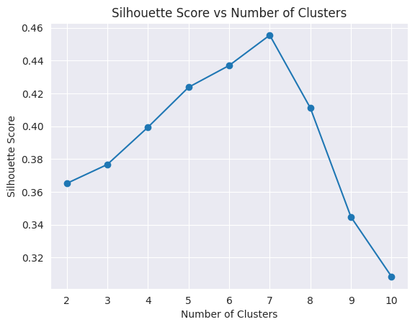
K-means
Using the sillouette score to get the best number of clusters and as we see we can notice that 7 is the best number of clusters to use

Slide 19
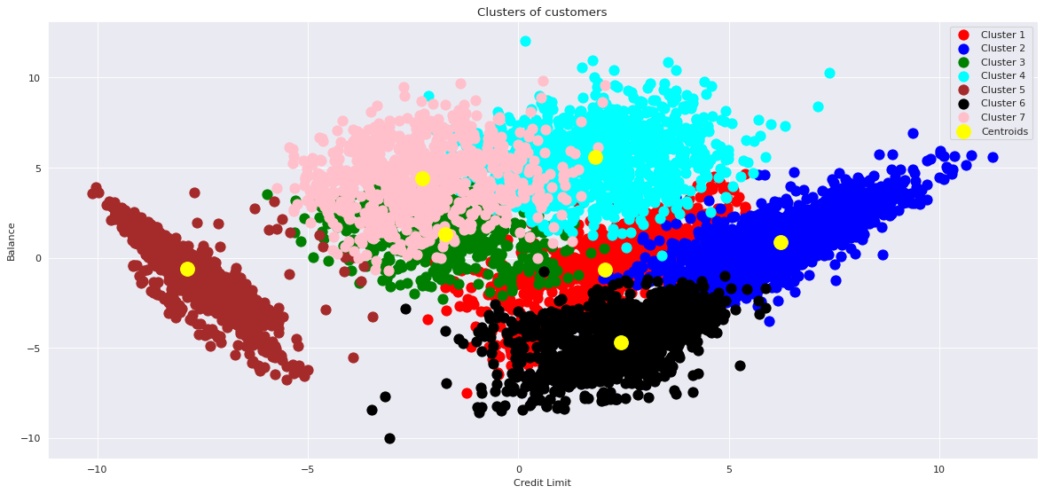
And after applying the K-means with 7 clusters we get this graph of clustering
And when we compute the silhouette score for the K-means clustering it was 0.518 which is a good value

Slide 20
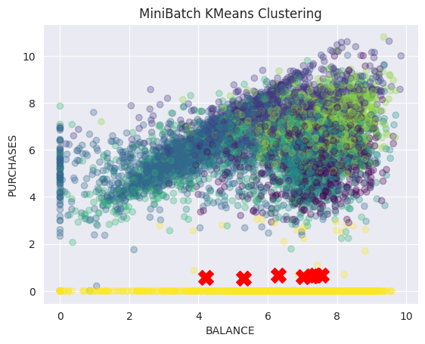
MiniBatch K-means
When we apply the MiniBach K-means we get this graph and silhouette score 0.491 which is also a good value

Slide 21
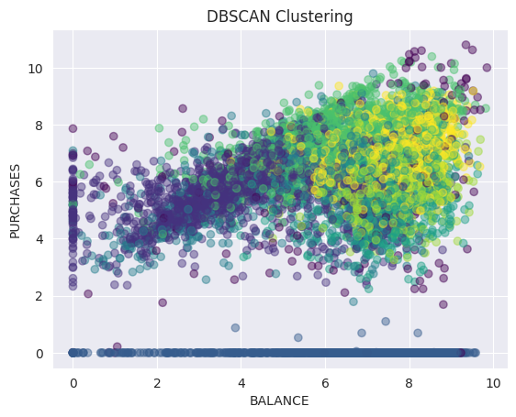
DBSCAN
Clustering data with DBSCAN with
eps=1.5 sets the maximum distance between two samples for one to be considered as in the neighborhood of the other. It determines the size of the neighborhood around each point.
min_samples=20 requires that a point has at least 20 neighbors within the distance eps to be considered a core point. This parameter controls the density required to form a cluster.
And the silhouette score was 0.447

Slide 22
Models comparison
K-means
silhouette score = 0.518
Davies-Bouldin Index = 0.764
MiniBatch K-means
silhouette score = 0.491
Davies-Bouldin Index = 0.981
DBSCAN
silhouette score = 0.447
Davies-Bouldin Index = 1.78
We can conclude that K-means is the best model because it has the highest silhouette value and lowest DBI value

